Slide 1
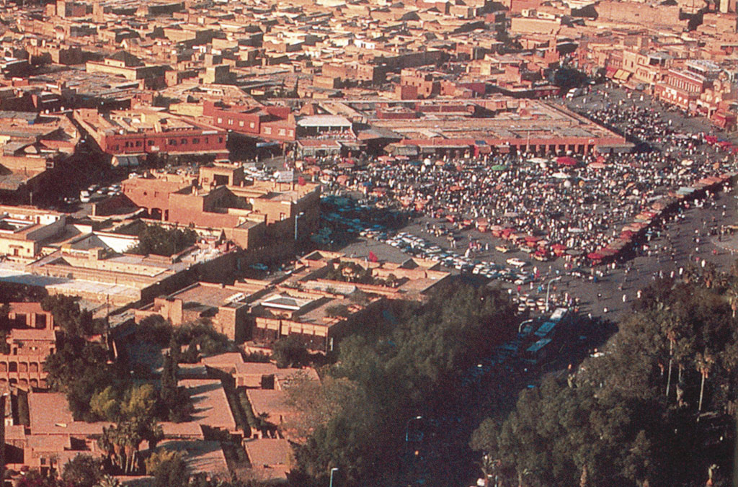
2001
WORLD HERITAGE IN MOROCCO
FOR PRESERVATION AND PROMOTION OF AN INTANGIBLE CULTURAL HERITAGE OF HUMANITY :
THE SPACE OF JAMAA EL-FNA SQUARE IN MARRAKECH
INTERNATIONAL CONFERENCE - NARA - JAPAN - OCTOBER 2004

Slide 2
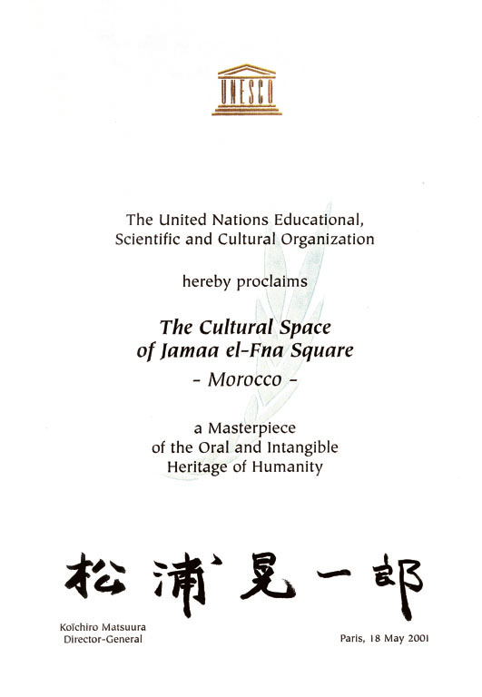
WORLD HERITAGE IN MOROCCO
FOR PRESERVATION AND PROMOTION OF AN INTANGIBLE CULTURAL HERITAGE OF HUMANITY :
THE SPACE OF JAMAA EL-FNA SQUARE IN MARRAKECH
MASTER PIECE OF THE ORAL AND INTANGIBLE HERITAGE OF HUMANITY
INTERNATIONAL CONFERENCE - NARA - JAPAN - OCTOBER 2004

Slide 3
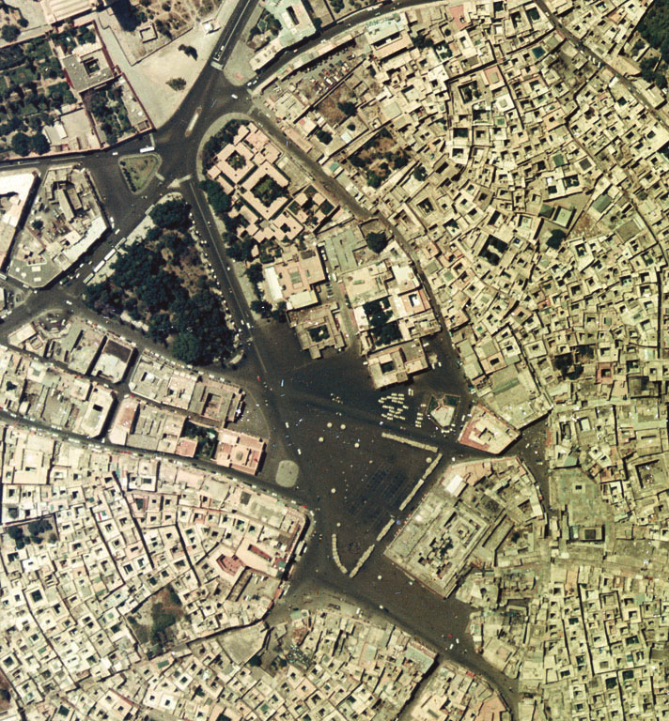
WORLD HERITAGE IN MOROCCO
FOR PRESERVATION AND PROMOTION OF AN INTANGIBLE CULTURAL HERITAGE OF HUMANITY :
THE SPACE OF JAMAA EL-FNA SQUARE IN MARRAKECH
AERIAN VIEWS
INTERNATIONAL CONFERENCE - NARA - JAPAN - OCTOBER 2004

Slide 4
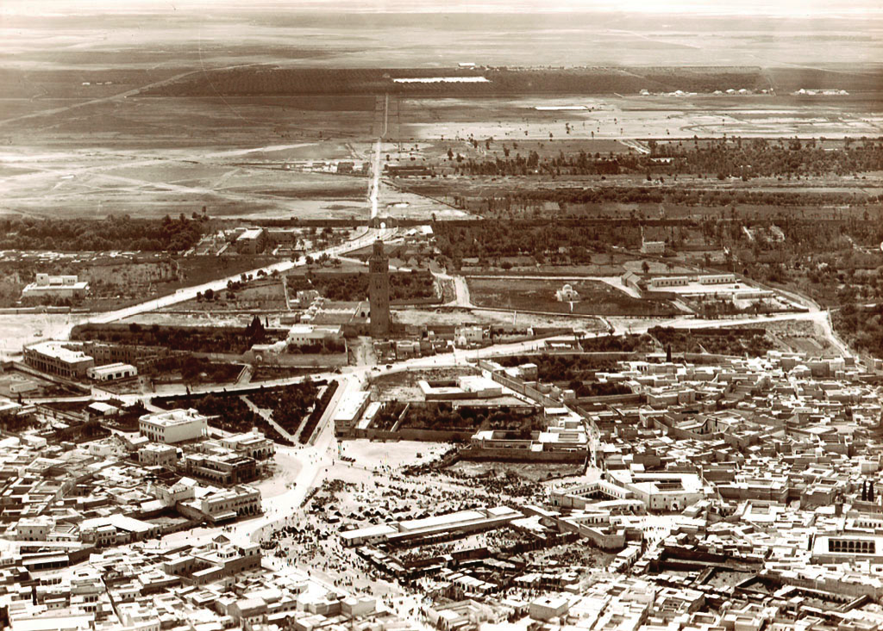
WORLD HERITAGE IN MOROCCO
FOR PRESERVATION AND PROMOTION OF AN INTANGIBLE CULTURAL HERITAGE OF HUMANITY :
THE SPACE OF JAMAA EL-FNA SQUARE IN MARRAKECH
AERIAN VIEWS
INTERNATIONAL CONFERENCE - NARA - JAPAN - OCTOBER 2004

Slide 5
" WORLD HERITAGE IN MOROCCO.
FOR THE PRESERVATION AND PROMOTION
OF AN INTANGIBLE CULTURAL HERITAGE OF HUMANITY :
THE SPACE OF JAMAA EL-FNA SQUARE IN MARRAKECH »
1./ INTRODUCTION
First of all, I would like to thank Mr. TATSUNO Yuichi , Director-General of the Cultural Properties Division of Bunka-cho, the Agency for Cultural Affairs of Japon for inviting me to participate in this International Conference on the theme of ″The Safeguard of Tangible and Intangible Cultural Heritage : Towards an Integrated Approach″. Thanks to him, I have the honor and the pleasure of being here among you. Thanks also to the UNESCO and to the Nara Prefectural Government, which co-organize this International Conference. For this reason, I’m pleased to have the opportunity today to present some specificities and studies of an Intangible Cultural Heritage of Humanity : The Space of Jamaa el-Fna Square in Marrakesh.
I propose to present a particular example, a paradoxical example, hoping to inspire debate and discussion. A discussion of the interest and value of cultural heritage, the nature of cultural heritage, the memory inscribed by mankind for mankind. A discussion of cultural identities in a world which talks more and more of globalization.
Before presenting this theme, I would like to make two remarks concerning the methodology in order to facilitate the presentation and also the orientation of our discussion. The first remark concerns the concept of "cultural heritage". Of course, in my mind, it is not a nostalgic or romantic conception of the past. As you know, every human space, every human settlement is a complex achievement. A complex achievement in which are integrated and materialized the relationships people have with each other and with their environment. The nature of the relationship which defines the cultural spaces, identifies citizens to their monuments and the monuments to their citizens. Thus, a cultural heritage is not only related to the tangible building itself. It is also related to the relationships allowing the human production to become real and concrete. The result is also materialized in surroundings and in patrimonial heritage, which is both memory and identity. Memory and identity are landmarks of the social and cultural space of our everyday life.
The second remark flows from the first. If cultural heritage is the result of differentiated social, cultural, historic and environmental relationships, it does not flow from a single source but rather from several sources. That is to say, it flows from a multitude of exchanges. Thus, in the long term, cultural heritage is the result of multiple determinisms, the fruit of cross fertilization.

Slide 6
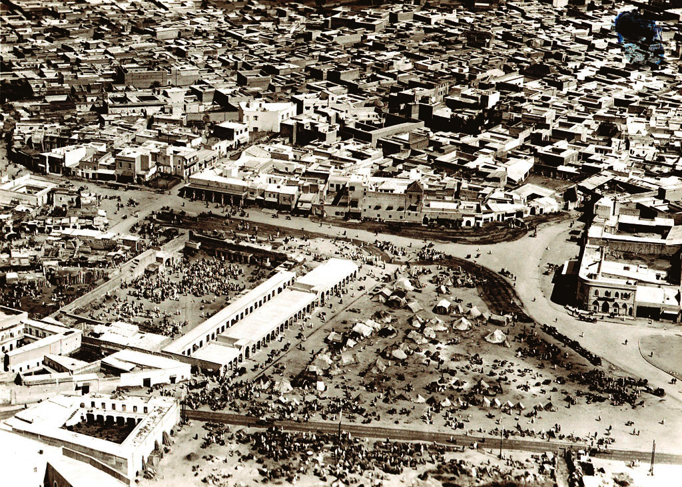
WORLD HERITAGE IN MOROCCO
FOR PRESERVATION AND PROMOTION OF AN INTANGIBLE CULTURAL HERITAGE OF HUMANITY :
THE SPACE OF JAMAA EL-FNA SQUARE IN MARRAKECH
AERIAN VIEWS
INTERNATIONAL CONFERENCE - NARA - JAPAN - OCTOBER 2004

Slide 7
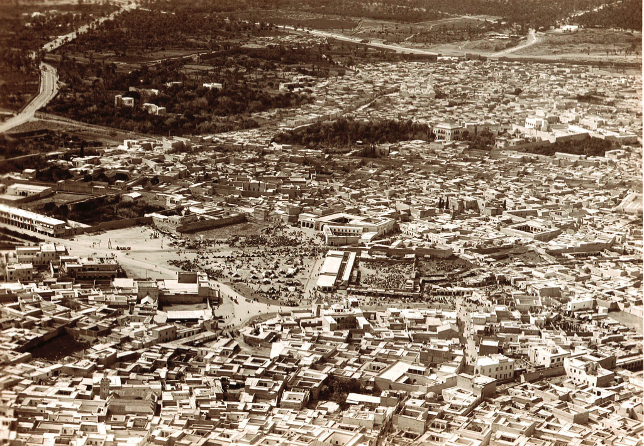
WORLD HERITAGE IN MOROCCO
FOR PRESERVATION AND PROMOTION OF AN INTANGIBLE CULTURAL HERITAGE OF HUMANITY :
THE SPACE OF JAMAA EL-FNA SQUARE IN MARRAKECH
AERIAN VIEWS
INTERNATIONAL CONFERENCE - NARA - JAPAN - OCTOBER 2004

Slide 8
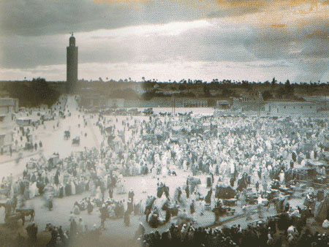
WORLD HERITAGE IN MOROCCO
FOR PRESERVATION AND PROMOTION OF AN INTANGIBLE CULTURAL HERITAGE OF HUMANITY :
THE SPACE OF JAMAA EL-FNA SQUARE IN MARRAKECH
AERIAN VIEWS
INTERNATIONAL CONFERENCE - NARA - JAPAN - OCTOBER 2004

Slide 9
2./ RESTITUTION
As you know, Morocco, is the juncture point of two continents and two seas and borders on the Sahara. Along its north coast, Morocco was open to successive Mediterranean civilizations, going back beyond the dawn of history and including the Phoenicians, the Carthaginians, the Greeks and the Romans. With the breaching of the mythological Columns of Hercules, Morocco's atlantic coast enters history. A saga ponctuated by exchanges and maritime battles between Islam and Christianity. A history rich with cultural sediments. Moslem fortifications along the road of Jihad, Portuguese fortifications to protect the route to the Indies and the founding of merchant cities in contact with northern Europe.
The border to the south involved Moroccans in others contexts, putting theim in contact with other civilizations and other networks of exchange and connecting them to the caravan roads which, since the IXth century, linked Morocco to the realm of Ghana, to the Senegal, the Sudan and the Far East via the Sahara. From large commercial settings in the Sahara, since the eleventh century, Almoravids and Almohads spread over a vaste empire stretching from the Sahara to the Golf of Gabes, from the Sahara to the north of Spain.It was from the great sites of commerce in the Sahara, that the Almoravid and the Almohad dynasties conquests spread over a vast empire, streching from the Sahara to the Gulf of Gabes, from the Sahara to the north of Spain.
In the same geographical aera, how would all these diverse civilizations, lead by differenciated knowledge, science, technology, arts, crafts, way of life, spiritual, cultural and aesthetics values, etc., happen to meet, confront, resolve and dissolve, through history, from the first human settlements to our current landmarks ?
What traces, vestiges, monuments and architecture would they deposit as a part of the historical heritage and the shared common references which form a nation, a cultural identity and also set up ties with others countries sharing partly this same tangible and intangible heritage ? These are some of the questions which probably warrant attention during our discussion. In any case, it seems useful to bring them up in the hope that they will prove helpful in orienting your reading and your understanding of my presentation. Hoping likewise to go deeply into this particular relationship between tangible and intangible cultural heritage, which is the nucleus of this International Conference.

Slide 10
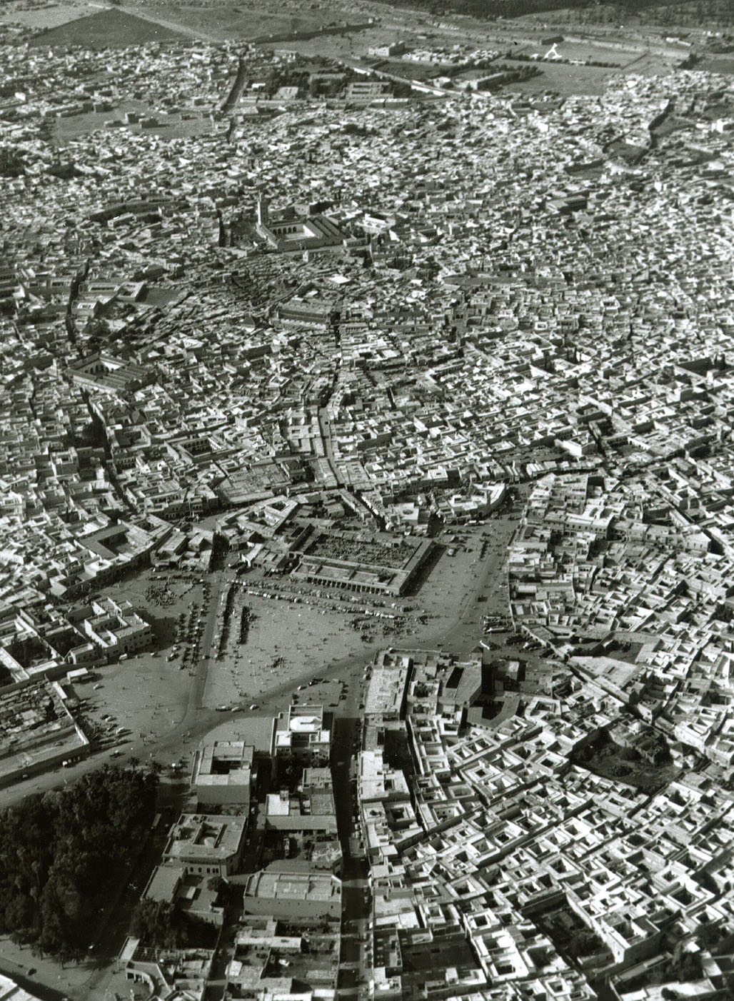
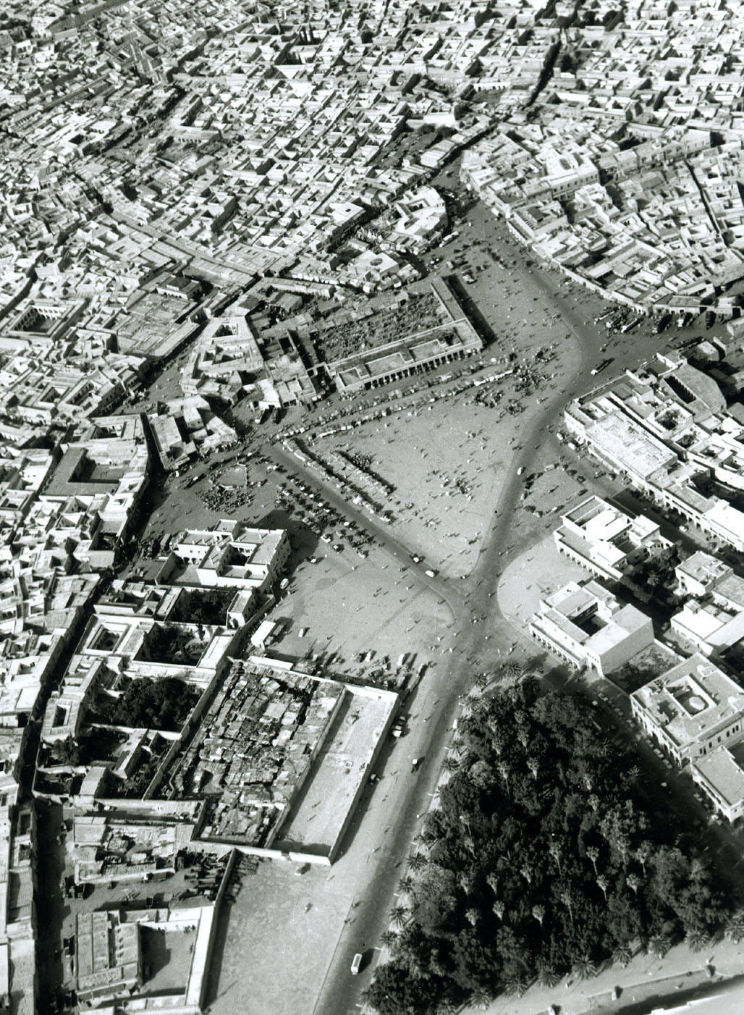
WORLD HERITAGE IN MOROCCO
FOR PRESERVATION AND PROMOTION OF AN INTANGIBLE CULTURAL HERITAGE OF HUMANITY :
THE SPACE OF JAMAA EL-FNA SQUARE IN MARRAKECH
AERIAN VIEWS
INTERNATIONAL CONFERENCE - NARA - JAPAN - OCTOBER 2004

Slide 11
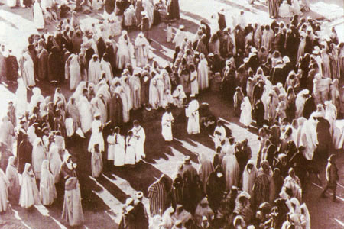
WORLD HERITAGE IN MOROCCO
FOR PRESERVATION AND PROMOTION OF AN INTANGIBLE CULTURAL HERITAGE OF HUMANITY :
THE SPACE OF JAMAA EL-FNA SQUARE IN MARRAKECH
HALQA OR CIRCLE'S SPECTACLE
INTERNATIONAL CONFERENCE - NARA - JAPAN - OCTOBER 2004

Slide 12
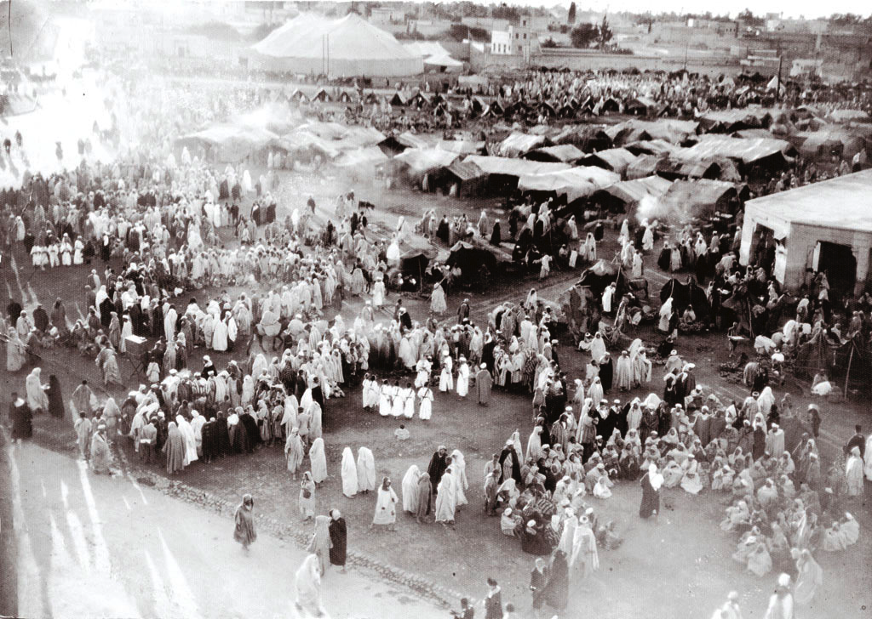
WORLD HERITAGE IN MOROCCO
FOR PRESERVATION AND PROMOTION OF AN INTANGIBLE CULTURAL HERITAGE OF HUMANITY :
THE SPACE OF JAMAA EL-FNA SQUARE IN MARRAKECH
HALQA OR CIRCLE'S SPECTACLE
INTERNATIONAL CONFERENCE - NARA - JAPAN - OCTOBER 2004

Slide 13
3./ THE SPACE OF JAMAA AL-FNA SQUARE IN MARRAKECH
3.A./ Background
The Jama’ al Fna is situated in the Medina in the heart of the city of Marrakech. This city, at the bottom of the Atlas and at the gate of the desert, was inscribed on the World Heritage List of UNESCO in 1985. It was founded in 1070 by the Almoravids and had a rapid development. In the 12th century, it was the capital of the Almohad empire which spread from the Atlantic to the Gulf of Gabes, from the Kingdom of Sudan to Andalusia. Historians and travellers have described with enthusiasm its vitality and the specificities of the multiple activities taking place on the Square. It is one of the rare squares in the world, which has kept its ancient characteristics and the multiple forms of popular cultural traditions which are daily created and renewed, and which maintain its international renown.
3.B./ Lords of Atlas
″Marrakesh was not only the market place of all the southern riches ; since early times it had become a pleasure town for the distant tribes-people who carried them here. The city had a perpetual floating population of some twelve thousand people : wild, pale-skinned Berbers from the mountain villages, black men from the edge of the desert, Arab tribes such as the Rehamna from the plains to the north and the West ; they came, they sold their goods, and had money to spend, so that the city became a sort of perpetual fun-fair. Close to the tall Koutoubia mosque, one of the grandest in the country, a great irregularly shaped open space of beaten earth, the Place Jamaa al-Fna has from the very early times been given up entirely to the use of public entertainers, around each of whom would form a dense circle of spectators, its circumference touching that of the next ring, so that the effect in looking down upon the scene from some elevated building is that of a formally-patterned carpet made of some fifteen thousand human beings. The sound of human voices comes up like the muted rumble of some vast engine, an undertone to the perpetual staccato urgency of drums , the wailing of reed pipes, the clang of cymbals, the shrill tinkle of water-sellers’ bells, the endless calling of the beggars - ″Allah ! Allah ! Allah ! ″ The fluid circles form and dissolve and reform around the snake-charmers and sword-swallowers and fire-eaters, all of the Essaoui sect, their hair falling in blue-black cascades over their shoulders ; gaudily dressed acrobats from Taroudant forming towers of multicoloured unidentifiable limbs ; conjurers and mimers , and story-tellers who hold a circle of a hundred solemn-faced children in hypnotized silence ; Berber dancers from the mountains, their white-robed lines swaying in rhythmic advance and withdrawal ; whirling black Gennaoua dancers from the Sudan, whose little conical caps, tasselled and embroidered with cowrie shells are spun fifty feet into the air as each dancer reaches the climax of his performance ; troops of Chleuch boys dancers with painted faces, waggling hips, and clicking

Slide 14
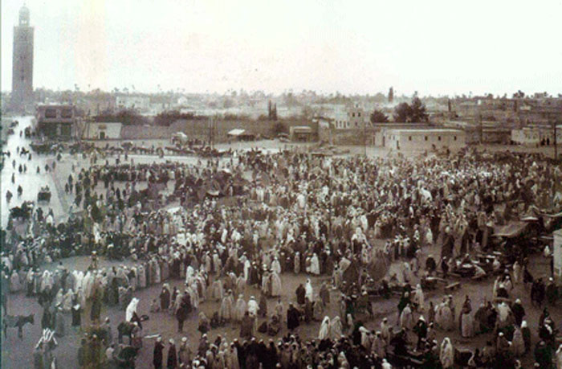
WORLD HERITAGE IN MOROCCO
FOR PRESERVATION AND PROMOTION OF AN INTANGIBLE CULTURAL HERITAGE OF HUMANITY :
THE SPACE OF JAMAA EL-FNA SQUARE IN MARRAKECH
HALQA OR CIRCLE'S SPECTACLE
INTERNATIONAL CONFERENCE - NARA - JAPAN - OCTOBER 2004

Slide 15
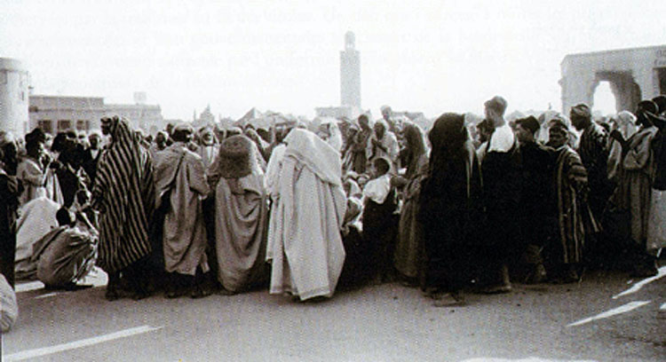
WORLD HERITAGE IN MOROCCO
FOR PRESERVATION AND PROMOTION OF AN INTANGIBLE CULTURAL HERITAGE OF HUMANITY :
THE SPACE OF JAMAA EL-FNA SQUARE IN MARRAKECH
HALQA OR CIRCLE'S SPECTACLE
INTERNATIONAL CONFERENCE - NARA - JAPAN - OCTOBER 2004

Slide 16
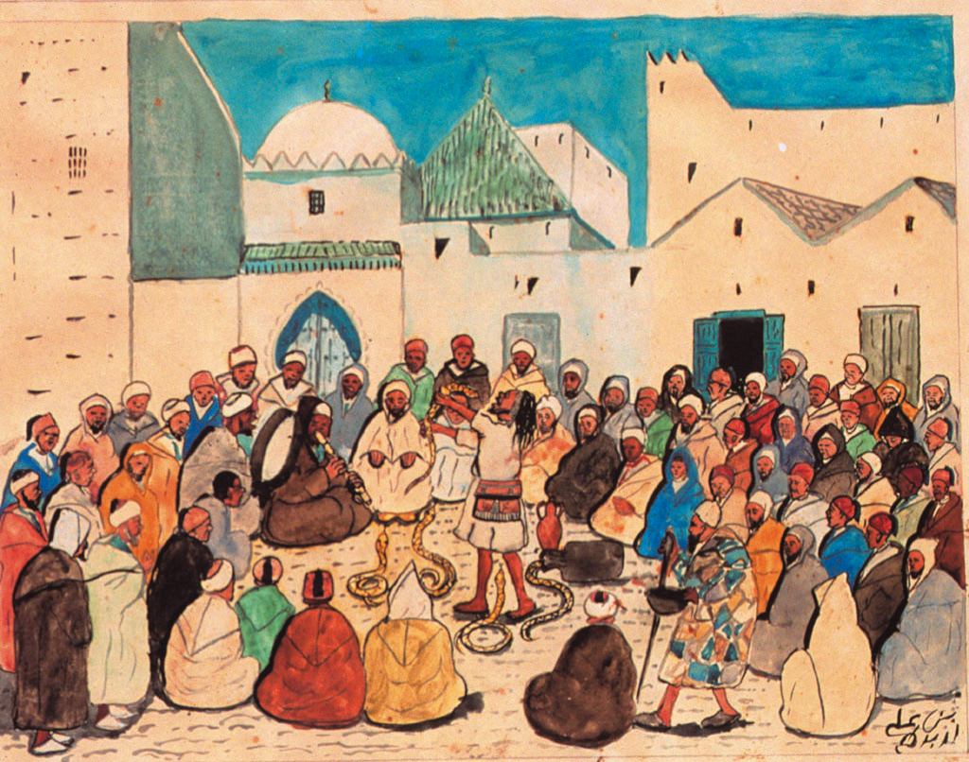
WORLD HERITAGE IN MOROCCO
FOR PRESERVATION AND PROMOTION OF AN INTANGIBLE CULTURAL HERITAGE OF HUMANITY :
THE SPACE OF JAMAA EL-FNA SQUARE IN MARRAKECH
HALQA OR CIRCLE'S SPECTACLE
INTERNATIONAL CONFERENCE - NARA - JAPAN - OCTOBER 2004

Slide 17
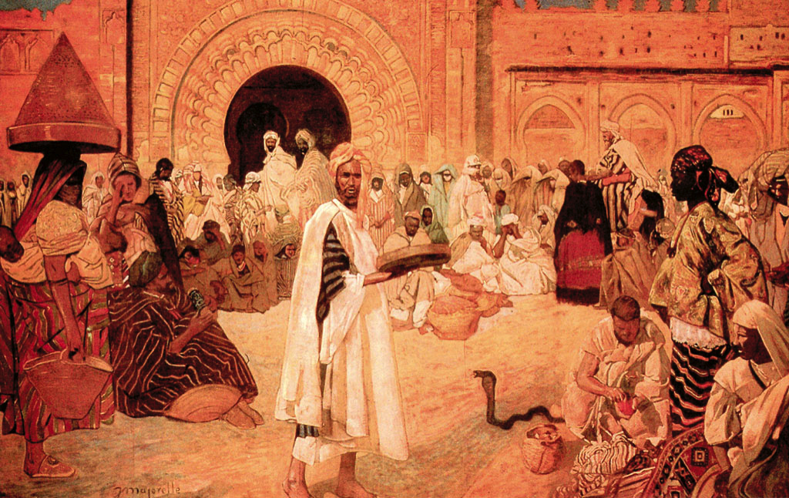
WORLD HERITAGE IN MOROCCO
FOR PRESERVATION AND PROMOTION OF AN INTANGIBLE CULTURAL HERITAGE OF HUMANITY :
THE SPACE OF JAMAA EL-FNA SQUARE IN MARRAKECH
TROUBADOURS AND ARTISTS
INTERNATIONAL CONFERENCE - NARA - JAPAN - OCTOBER 2004

Slide 18
castanets, their bare feet flicking through the intricate pattern of the dance, while their eyes rove the circle for evening clients ; performing monkeys, fortune tellers, clowns – all these and their exotic audiences have been part of the Jamaa al-Fna for hundred of years. Towards evening the din becomes crescendo ; the sun sinks and lights the towering snow peaks of the Atlas to orange and pink ; the shadows of the thronged spectators in the Jamaa al-Fna become long black spikes that join group to group like the bars of an iron grille ; over their heads drift homing flights of the numberless white egrets that roost nightly on the roofs above the wool market, their breats lit with the same fiery colours that glow on the mountain snows. ″
4./ Jamaa al-Fna : Masterpiece of Intangible Cultural Heritage
In the 1920s, the Square benefited from a protection. However, the growth and modernization of Marrakech, mostly in the last two decades of the 20th century, have increased its vulnerability and led to an increasing awareness of citizens concerning the necessity of its preservation and revitalization through a variety of actions, alongside with the Association ″Jama’ al Fna – Oral Heritage of Humanity ″ which was created in this purpose. Various activities including the necessity of an awareness campaign regarding the cultural and intangible values contained in the Square, the enhancing of its singularity and of its specificities.
Furthermore, on 18 May 2001, the Director-General of UNESCO, Mr. Koïchiro Matsuura, proclaimed the Cultural Space of the Jama’ al Fna Square a ″Masterpiece of the Oral and Intangible Heritage of Humanity″. This fact represented an important step in the actions and objectives of the Association and also the recognition of intangible cultural heritage and its universal values.
5./ The project for the preservation and promotion of the Square
The project conceived and presented by the Architecture Direction, aims to embrace the Square in all its intangible dimensions (oral, gestual and corporeal) within the physical space where they are expressed. It is a unique space which is daily transformed in an urban and open theatre. It is also a cultural crossroads and a space of exchange, conviviality and creativity in various fields of forms or expressions of popular traditions: story-telling and performances in the ″halqas″, acrobatics, music performances, comic theatre, dance, animal shows, traditional medicine (herb), henna tattoo business, etc.
The natural presence of tangible heritage has long set aside the requirements of safeguarding the rich but fragile dimension of popular culture in which a collective imaginary is materialized. Oral culture presupposes a continuous and open space that no physical monumentality breaks and interrupts. However, the vulnerability of the Square is rooted in the general process of modernization of the city. Furthermore, the authenticity of the Square is increasingly eroded by some aspects of tourism which affect the good reputation of the Square.

Slide 19
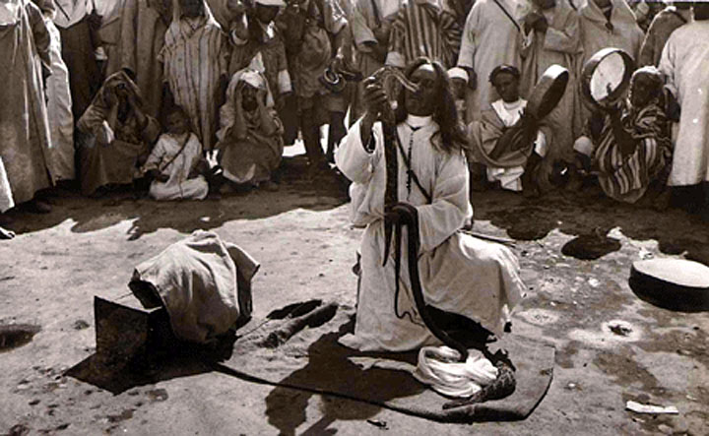
WORLD HERITAGE IN MOROCCO
FOR PRESERVATION AND PROMOTION OF AN INTANGIBLE CULTURAL HERITAGE OF HUMANITY :
THE SPACE OF JAMAA EL-FNA SQUARE IN MARRAKECH
TROUBADOURS AND ARTISTS
INTERNATIONAL CONFERENCE - NARA - JAPAN - OCTOBER 2004

Slide 20
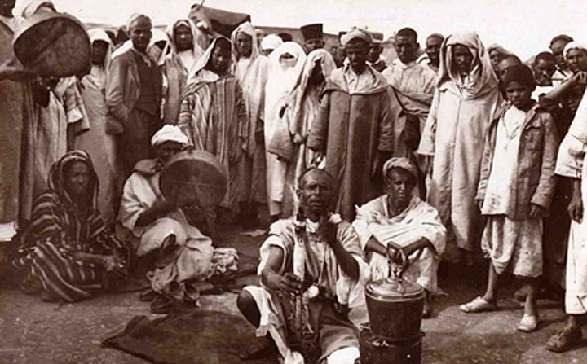
WORLD HERITAGE IN MOROCCO
FOR PRESERVATION AND PROMOTION OF AN INTANGIBLE CULTURAL HERITAGE OF HUMANITY :
THE SPACE OF JAMAA EL-FNA SQUARE IN MARRAKECH
TROUBADOURS AND ARTISTS
INTERNATIONAL CONFERENCE - NARA - JAPAN - OCTOBER 2004

Slide 21
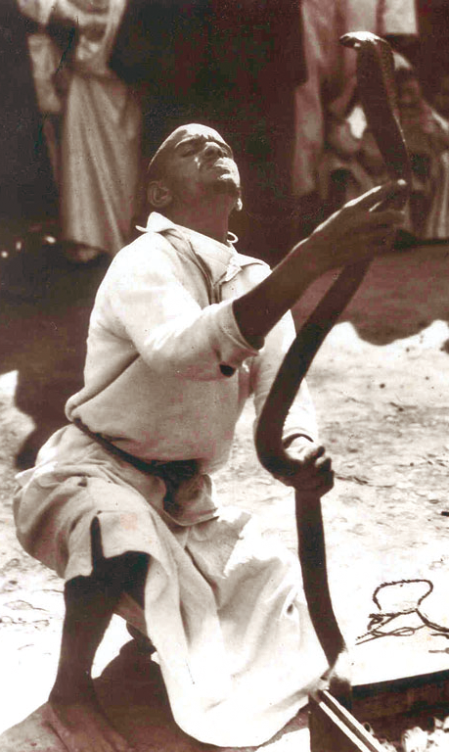
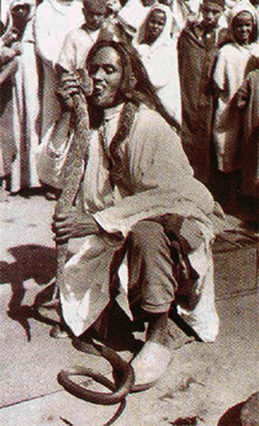
WORLD HERITAGE IN MOROCCO
FOR PRESERVATION AND PROMOTION OF AN INTANGIBLE CULTURAL HERITAGE OF HUMANITY :
THE SPACE OF JAMAA EL-FNA SQUARE IN MARRAKECH
TROUBADOURS AND ARTISTS
INTERNATIONAL CONFERENCE - NARA - JAPAN - OCTOBER 2004

Slide 22
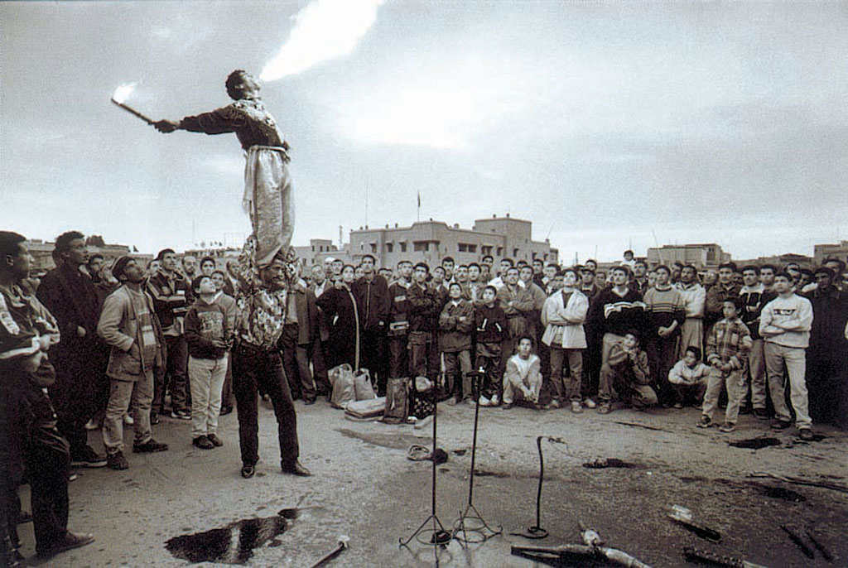
WORLD HERITAGE IN MOROCCO
FOR PRESERVATION AND PROMOTION OF AN INTANGIBLE CULTURAL HERITAGE OF HUMANITY :
THE SPACE OF JAMAA EL-FNA SQUARE IN MARRAKECH
TROUBADOURS AND ARTISTS
INTERNATIONAL CONFERENCE - NARA - JAPAN - OCTOBER 2004

Slide 23
5.A./ Some objectives
. Organize a two-day seminar;
. Edit books (such as anthologies of story-telling), didactic materials, etc.;
. Create a web site;
. Organize pedagogical workshops for the students of Marrakech animated by the Halqas of the Jamaa al-Fna Square;
. Organize thematic exhibits;
. Organize bi-annual Prizes and painting contests ;
. Train staff of the Association ″Jamaa al-Fna – Oral Heritage of Humanity″;
. Elaborate thematic studies on sociological specificities of the actors, on the transmission modes of knowledge or of practices in danger of disappearance ;
. Create archives (sound, graphic, iconographic, cinematographic) ;
5.B./ Expected results
. Identifying the main problems encountered on the Square and elaborating a general strategy for operational action ;
. Raising awareness within schools through the publication of didactical materials and anthologies of story-telling ;
. Raising awareness at the national and international level and giving access to information through the web site on the Jamaa al-Fna Square
. Transmitting knowledge from generation to generation through the organization of pedagogical workshops, etc. ;
. Disseminating and raising awareness within society at large on the identity and specificities of intangible cultural heritage of the Jamaa al-Fna Square through publications (anthologies of story-telling), exhibits, etc. ;
. Encouraging creativity through the organization of bi-annual Prizes and painting contests for children ;
. Strengthening expertise for the realization of the project components through the training of staff of the Association ″Jamaa al-Fna – Oral Heritage of Humanity″ ;
. Identifying practices in danger of disappearance (through studies) in order to promote their transmission ;
. Safeguarding of the intangible cultural heritage of the Jamaa al-Fna through the collection and archiving of data ;
. Raising awareness of the significance and importance of conserving, maintaining and transmitting intangible cultural heritage ; .Giving access to the data collected at the national and international level, etc. ;

Slide 24
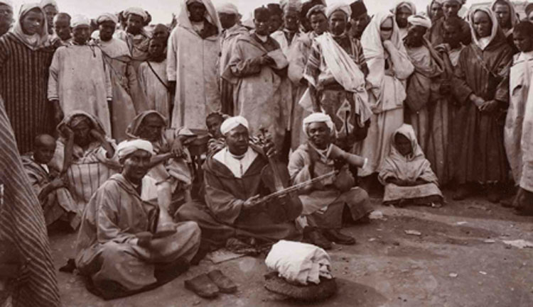
WORLD HERITAGE IN MOROCCO
FOR PRESERVATION AND PROMOTION OF AN INTANGIBLE CULTURAL HERITAGE OF HUMANITY :
THE SPACE OF JAMAA EL-FNA SQUARE IN MARRAKECH
TROUBADOURS AND ARTISTS
INTERNATIONAL CONFERENCE - NARA - JAPAN - OCTOBER 2004

Slide 25
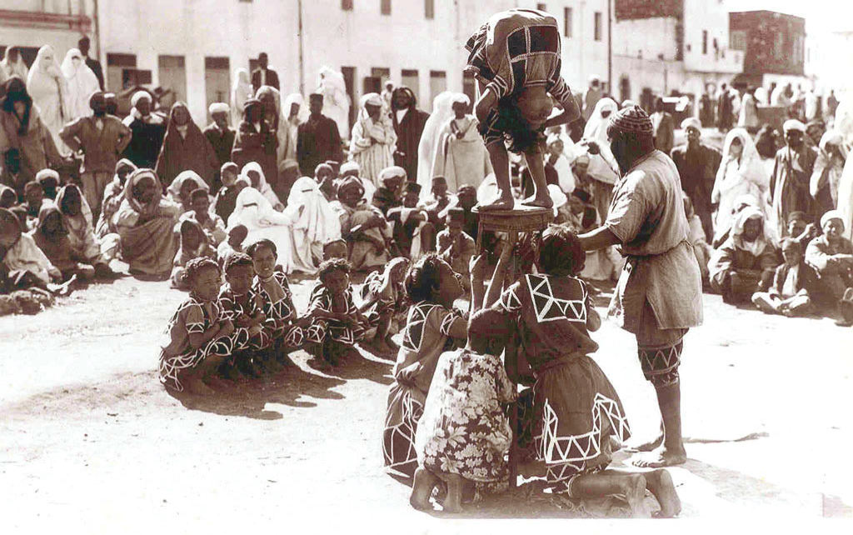
WORLD HERITAGE IN MOROCCO
FOR PRESERVATION AND PROMOTION OF AN INTANGIBLE CULTURAL HERITAGE OF HUMANITY :
THE SPACE OF JAMAA EL-FNA SQUARE IN MARRAKECH
TROUBADOURS AND ARTISTS
INTERNATIONAL CONFERENCE - NARA - JAPAN - OCTOBER 2004

Slide 26
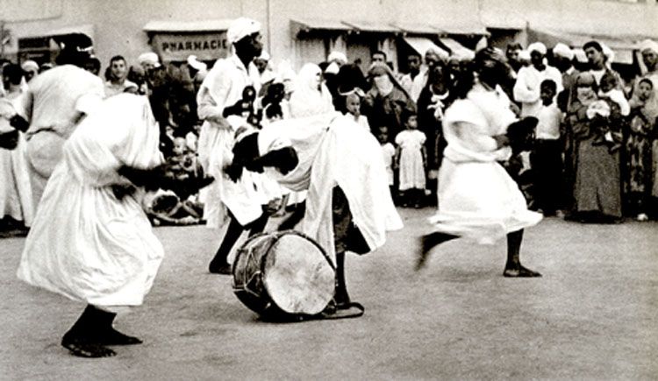
WORLD HERITAGE IN MOROCCO
FOR PRESERVATION AND PROMOTION OF AN INTANGIBLE CULTURAL HERITAGE OF HUMANITY :
THE SPACE OF JAMAA EL-FNA SQUARE IN MARRAKECH
TROUBADOURS AND ARTISTS
INTERNATIONAL CONFERENCE - NARA - JAPAN - OCTOBER 2004

Slide 27
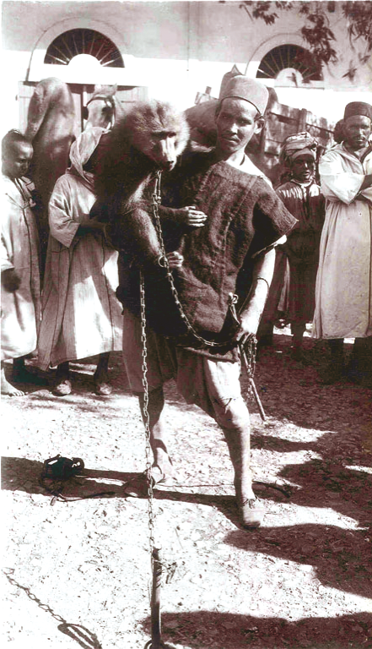
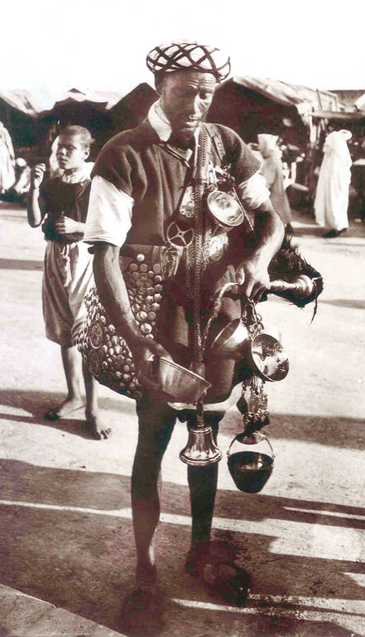
WORLD HERITAGE IN MOROCCO
FOR PRESERVATION AND PROMOTION OF AN INTANGIBLE CULTURAL HERITAGE OF HUMANITY :
THE SPACE OF JAMAA EL-FNA SQUARE IN MARRAKECH
TROUBADOURS AND ARTISTS
INTERNATIONAL CONFERENCE - NARA - JAPAN - OCTOBER 2004

Slide 28
6./ CONCLUSION
As you no doubt know, the purpose of this International Conference is more than a research for an active defense of the cultural heritage. It is a militant combat. A militant combat in the field of conceptualisation. What does tangible heritage mean and what does intangible heritage mean. What is the origin of this distinction ? What happened between the Convention of 1972 and the proclamation by the UNESCO of ″Masterpieces of Oral and Intangible Heritage of Humanity″, in May 2001? Following my point of view, we cannot imagine an ″integrated approach″ if we don’t state clearly this evolution from tangible to intangible, if we don’t analyse what really happened between 1972 and 2001, and also what exactly Heritage and Heritage of the Humanity mean. In fact, one of the more important questions is the definition of Culture in UNESCO institution and the implicit evolution of this definition between 1972 and 2001. In other words, what are the causes and the consequences of this fracture ? All these questions could seem naive, but if they remain unanswered, how could we get an ″integrated approach″ of such undefined things, which have so far not been deeply analyzed.
It reminds to me the harmony that connects notes and silences in music. ″When you listen to Mozart, the silence that follows is also Mozart″ used to say the French famous scenarist and author Sacha Guitry. When I listen to Abd al-Bassit Abd al-Samad psalmodiing Koran’s surats, the silence separating the versets fully belongs to the incantation. Same for Munir Bashir ″Maqamâts″ or for soufi songs of Nusrat Fateh Ali Khan. You cannot define the silence without defining the musical note and vice versa.
If we follow this analogy, it appears to me that UNESCO defined the ″note″ in 1972 and tried to define the ″silence″ in 2001. So we have to imagine, in this International Conference, an ″integrated approach″ of the ″note of 1972″ and the ″silence of 2001″. But after thirty years, the frame is no more the same, the music has changed, the harmony has changed. Even the definition of Culture and of Heritage have changed. The vision of Humanity has changed too. We cannot go on, we cannot operate with the same concepts and the same words. We need a real catharsis. We absolutly need to understand the evolution of human values in history, before thinking about an ″integrated approach″. With the respect to regional and local cultures, with the respect for the soul and the spirit of the site.
It seems to me essential to precise the ties between tangible and intangible cultural heritage. This heritage sets up, on the one hand, a major side of specific identities, and on the other hand, a bridge that connects to other countries, other districts, specially during this globalization and growing communication time. To strengthen ties and and to preserve ties with UNESCO

Slide 29
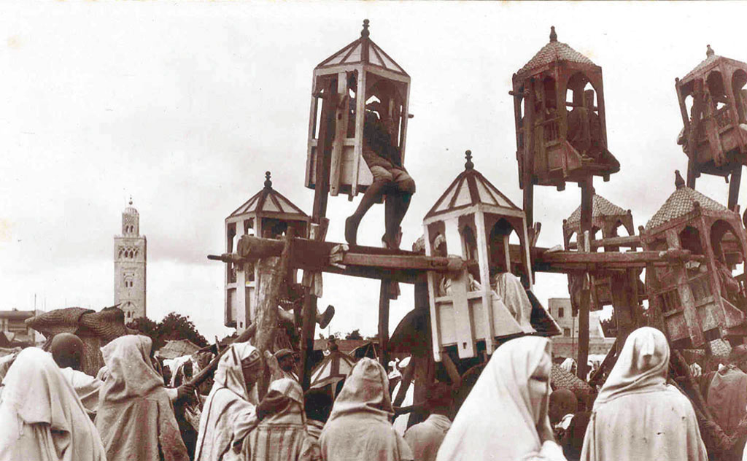
WORLD HERITAGE IN MOROCCO
FOR PRESERVATION AND PROMOTION OF AN INTANGIBLE CULTURAL HERITAGE OF HUMANITY :
THE SPACE OF JAMAA EL-FNA SQUARE IN MARRAKECH
TROUBADOURS AND ARTISTS
INTERNATIONAL CONFERENCE - NARA - JAPAN - OCTOBER 2004

Slide 30
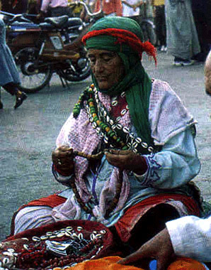
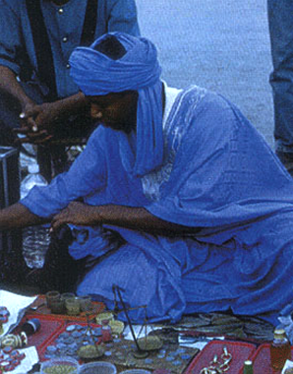
WORLD HERITAGE IN MOROCCO
FOR PRESERVATION AND PROMOTION OF AN INTANGIBLE CULTURAL HERITAGE OF HUMANITY :
THE SPACE OF JAMAA EL-FNA SQUARE IN MARRAKECH
TROUBADOURS AND ARTISTS
INTERNATIONAL CONFERENCE - NARA - JAPAN - OCTOBER 2004

Slide 31
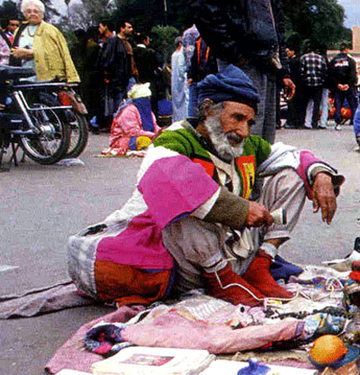
WORLD HERITAGE IN MOROCCO
FOR PRESERVATION AND PROMOTION OF AN INTANGIBLE CULTURAL HERITAGE OF HUMANITY :
THE SPACE OF JAMAA EL-FNA SQUARE IN MARRAKECH
TROUBADOURS AND ARTISTS
INTERNATIONAL CONFERENCE - NARA - JAPAN - OCTOBER 2004

Slide 32
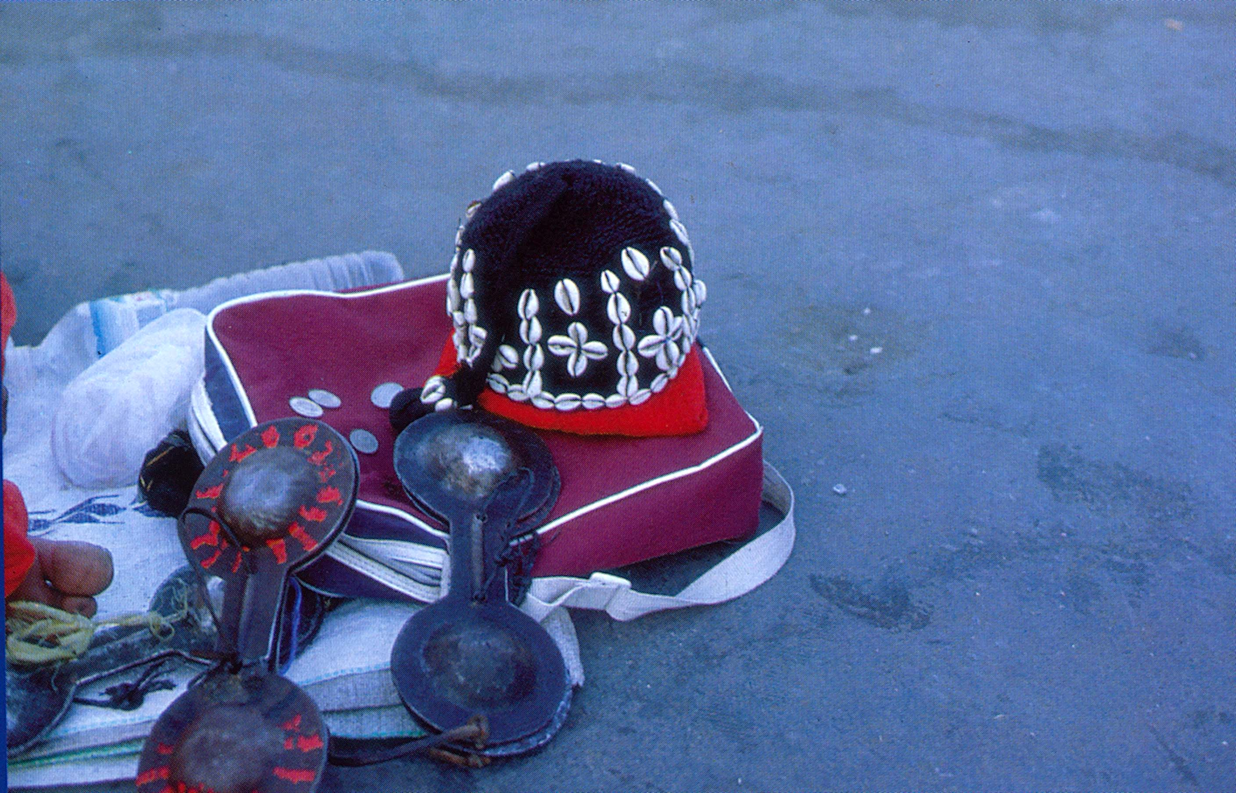
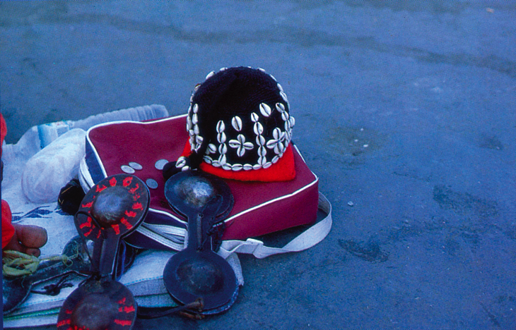
WORLD HERITAGE IN MOROCCO
FOR PRESERVATION AND PROMOTION OF AN INTANGIBLE CULTURAL HERITAGE OF HUMANITY :
THE SPACE OF JAMAA EL-FNA SQUARE IN MARRAKECH
TROUBADOURS AND ARTISTS
INTERNATIONAL CONFERENCE - NARA - JAPAN - OCTOBER 2004

Slide 33
classified World Heritage, before it is to late. From the 1972 Chart, to the proclamation of Masterpieces of Oral and Intangible Cultural Heritage in 2001, intangible heritage was not considered. Only recently, intangible heritage has been considered as a major part of universality and specifity of human beings.
Intangible, oral and non material Humanity’s cultural heritage, has long remained in the background. A fragile, hard to define heritage. A threatened heritage because of its transmission modes and the popular kinds of culture it carries. UNESCO’s effort to preserve the intangible heritage are recent. We all of us hope they will go on successfully as boundaries faint and globalization progresses. We also hope this progression not be detrimental to local and regional cultural values. I have the feeling that the more deeply rooted and conscious of our identity we are, the more open we can be to real dialogue and to acceptance of other people’s diversity and specific heritage. Thus, diversified cultures might become a vector to meeting and to reciprocal recognizing, a vector of shared values, a vector of peace in a world that needs it more and more.
Working together, with UNESCO’s partnership, to promote and revitalize cultural heritage. Let’s work to set up a global view, a synthetical view of humanity’s tangible and intangible heritages. So doing, we are working to strengthen peace in the world. We are inviting younger generations to develop the most noble values of every human beings. The values which compose his culture. The values expressed and materiazlized in arts, ethic and aesthetics.. Because, all of us know that sustainable developpement cannot occur without preservation, actualization and innovation in the cultural field.
Nara, october 2004.
Saïd Mouline
Architect , sociologist

Slide 34
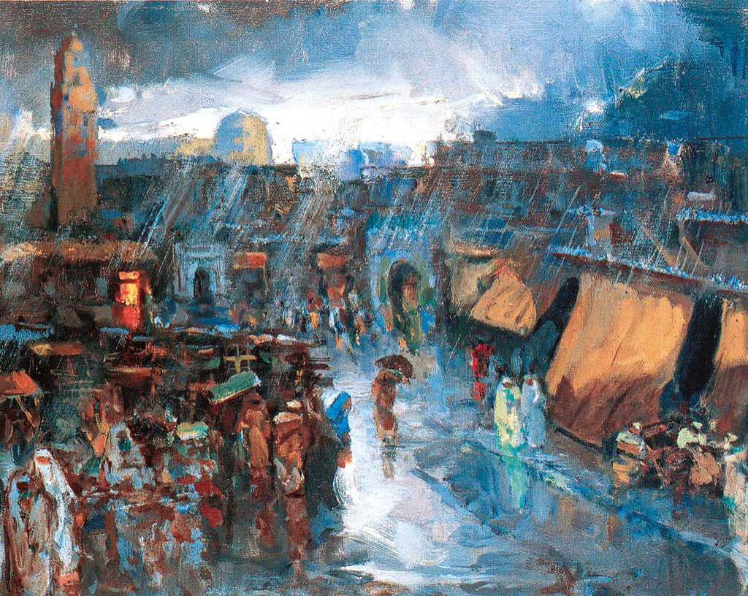
WORLD HERITAGE IN MOROCCO
FOR PRESERVATION AND PROMOTION OF AN INTANGIBLE CULTURAL HERITAGE OF HUMANITY :
THE SPACE OF JAMAA EL-FNA SQUARE IN MARRAKECH
THE TURNING POINT
INTERNATIONAL CONFERENCE - NARA - JAPAN - OCTOBER 2004

Slide 35
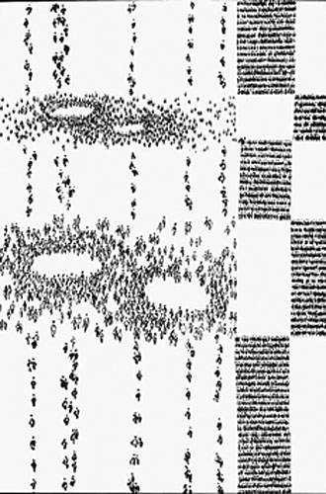
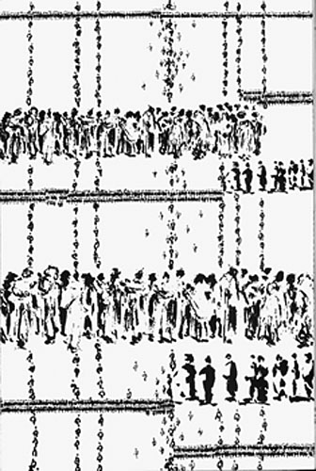
WORLD HERITAGE IN MOROCCO
FOR PRESERVATION AND PROMOTION OF AN INTANGIBLE CULTURAL HERITAGE OF HUMANITY :
THE SPACE OF JAMAA EL-FNA SQUARE IN MARRAKECH
THE TURNING POINT
INTERNATIONAL CONFERENCE - NARA - JAPAN - OCTOBER 2004

Slide 36
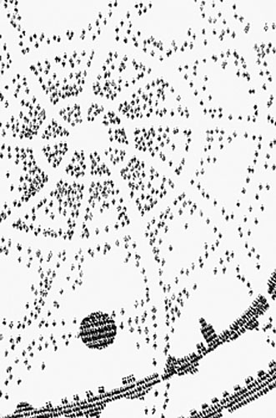
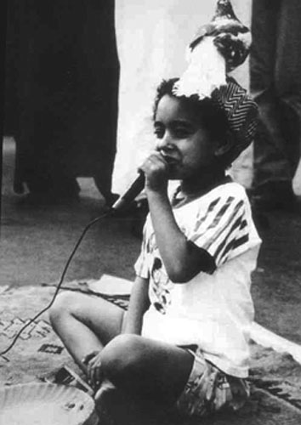
WORLD HERITAGE IN MOROCCO
FOR PRESERVATION AND PROMOTION OF AN INTANGIBLE CULTURAL HERITAGE OF HUMANITY :
THE SPACE OF JAMAA EL-FNA SQUARE IN MARRAKECH
THE TURNING POINT
INTERNATIONAL CONFERENCE - NARA - JAPAN - OCTOBER 2004

Slide 37
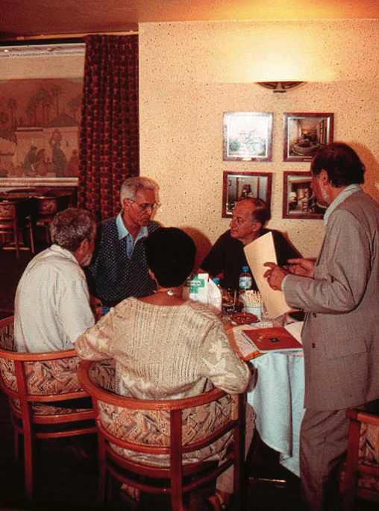
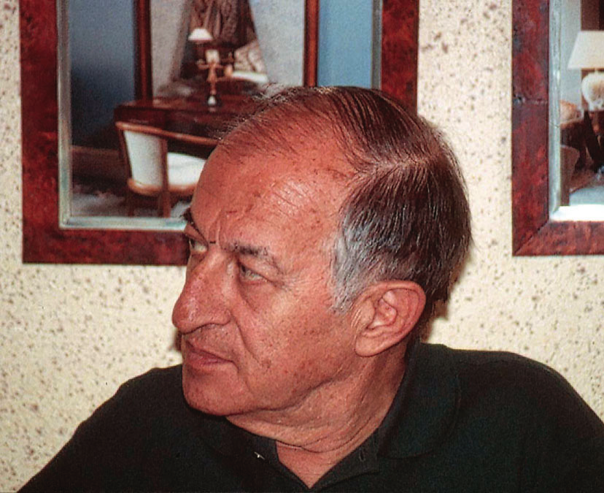
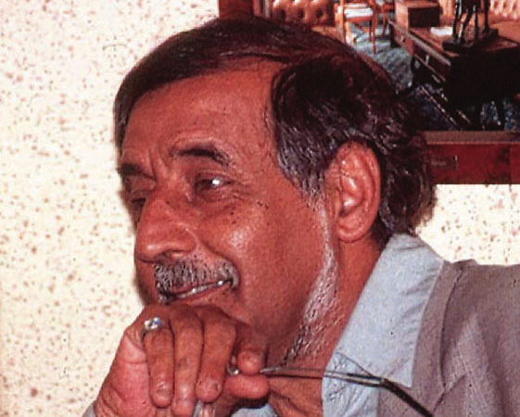
WORLD HERITAGE IN MOROCCO
FOR PRESERVATION AND PROMOTION OF AN INTANGIBLE CULTURAL HERITAGE OF HUMANITY :
THE SPACE OF JAMAA EL-FNA SQUARE IN MARRAKECH
THE TURNING POINT
INTERNATIONAL CONFERENCE - NARA - JAPAN - OCTOBER 2004

Slide 38
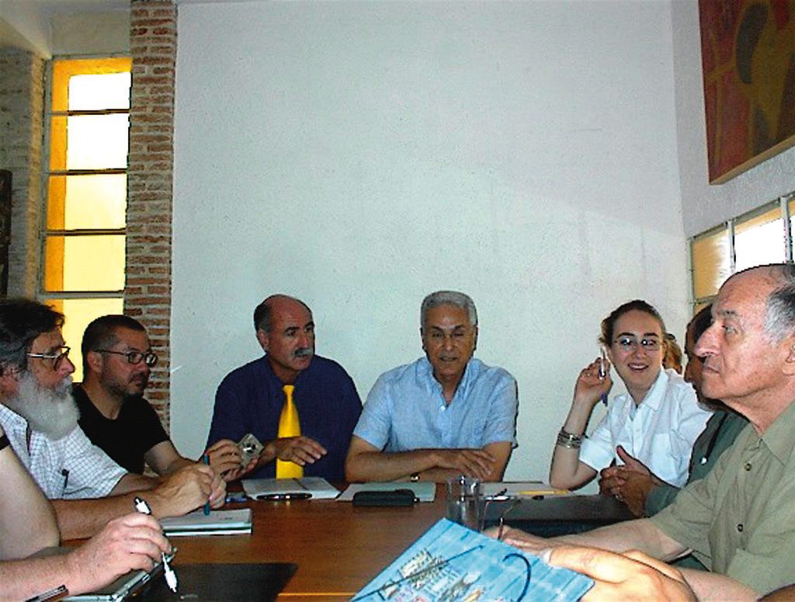
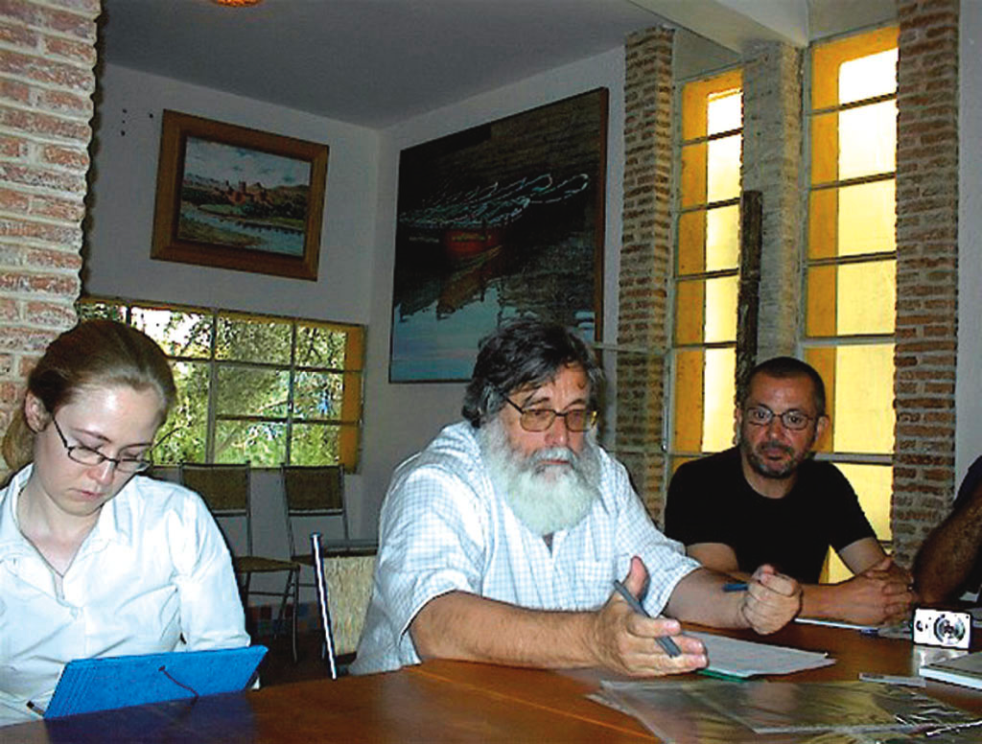
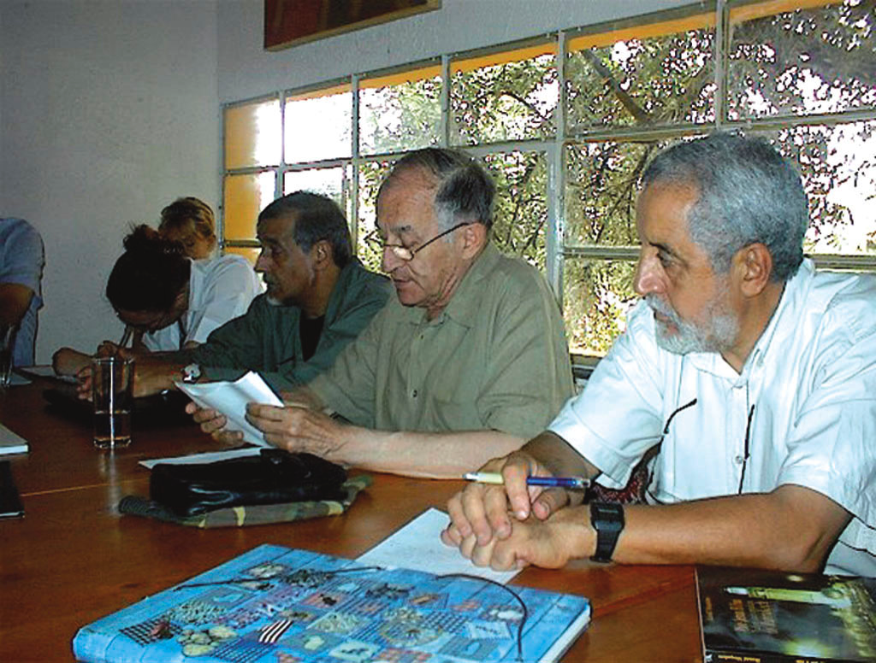
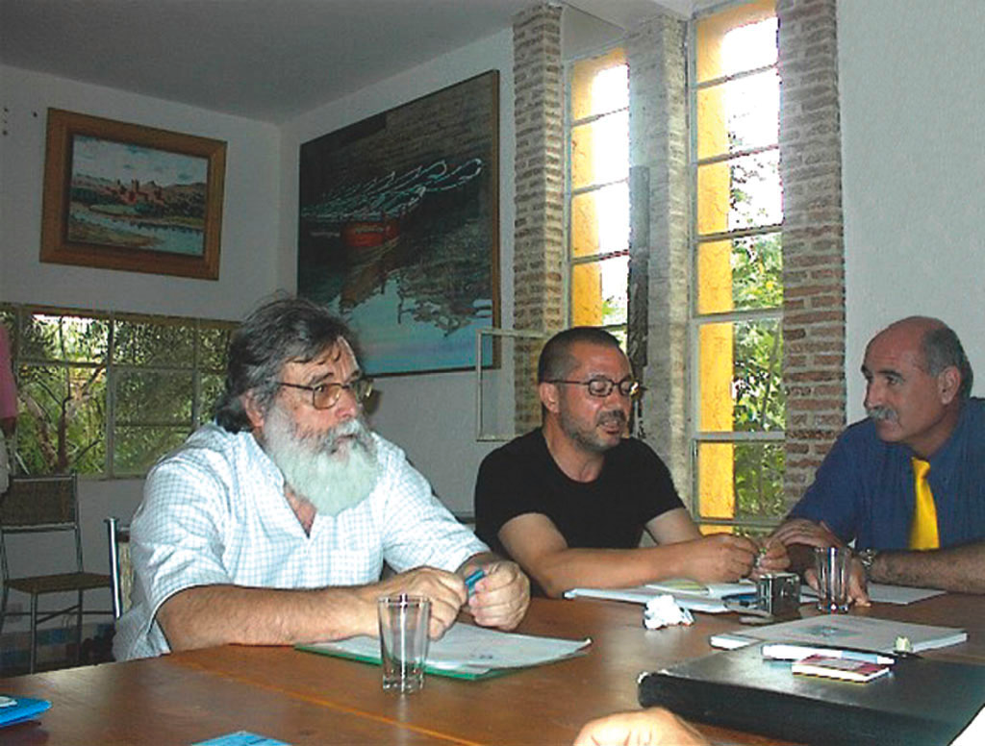
WORLD HERITAGE IN MOROCCO
FOR PRESERVATION AND PROMOTION OF AN INTANGIBLE CULTURAL HERITAGE OF HUMANITY :
THE SPACE OF JAMAA EL-FNA SQUARE IN MARRAKECH
THE TURNING POINT
INTERNATIONAL CONFERENCE - NARA - JAPAN - OCTOBER 2004

Slide 39
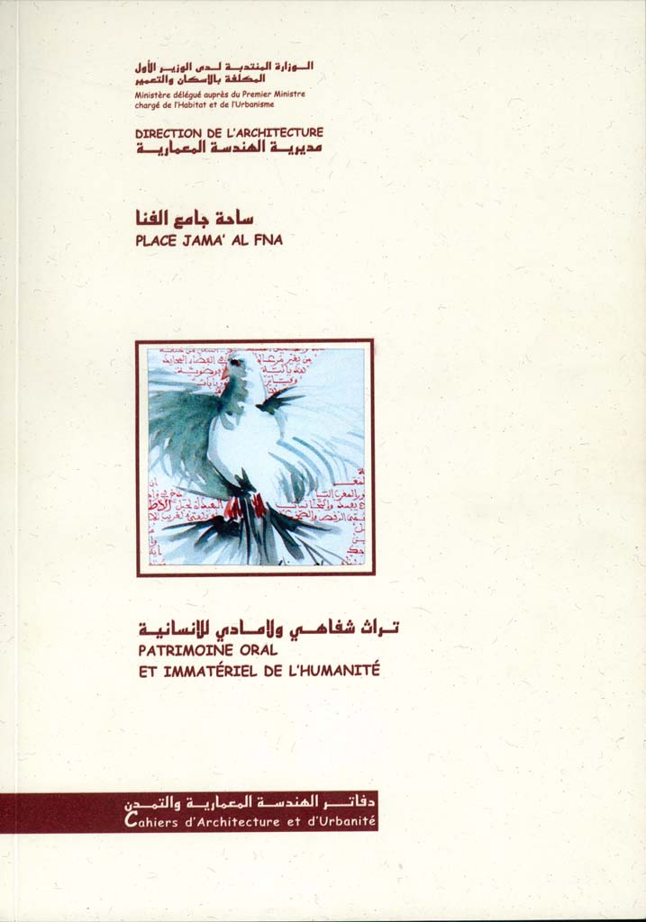
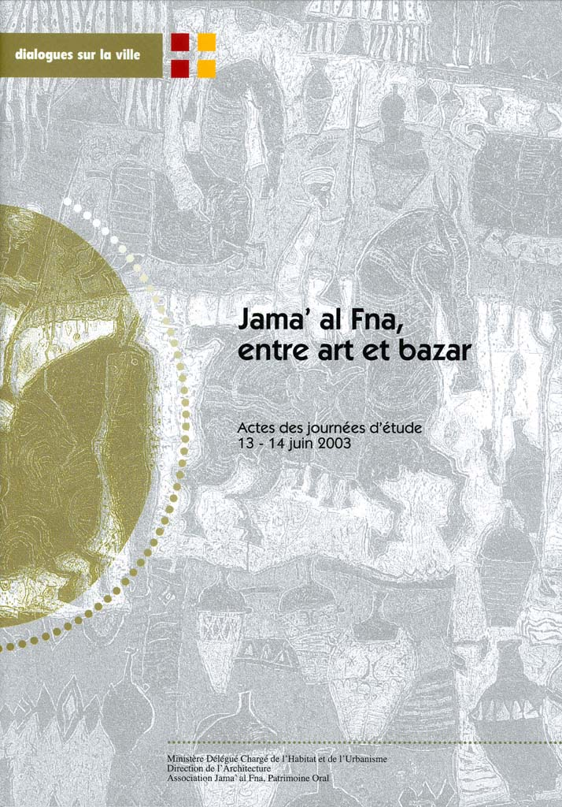
WORLD HERITAGE IN MOROCCO
FOR PRESERVATION AND PROMOTION OF AN INTANGIBLE CULTURAL HERITAGE OF HUMANITY :
THE SPACE OF JAMAA EL-FNA SQUARE IN MARRAKECH
THE TURNING POINT
INTERNATIONAL CONFERENCE - NARA - JAPAN - OCTOBER 2004

Slide 40
FIN

